Slide 1
Fiduciary Duties for Investors
John Kay
European Investors Association Autumn Event
13 September 2018

Slide 2
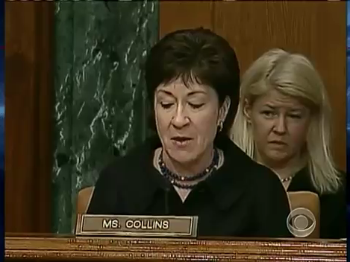
Sen. Collins: Did you consider yourself to have a duty to act in the best interest of your clients?
Mr Sparks: I had a duty to act in a very straightforward way, in a very open way with my clients. Technically, with respect to investment advice, we were a market maker in that regard. But with respect to being a prudent and a responsible participant in that market, we do have a duty to do that.
Sen. Collins: … did the firm expect you to act in the best interests of your clients as opposed to acting in the best interests of the firm?
Mr Sparks: Well, when I was at Goldman Sachs, clients are very important and were very important and so …
Sen. Collins: Could you give me a yes or no to whether or not you have a duty to act in the best interests of your clients?
Mr Sparks: … believe we have a duty to serve our clients well.
Congressional testimony, 27 April 2010, with Senator S.M. Collins (R, Maine) and D.L. Sparks, former partner and head of mortgage department, Goldman Sachs
Notes:
http://www.c-span.org/video/?293196-1/investment-banks-financial-crisis-directors [1hr 35mins]
http://www.c-span.org/video/?293196-3/investment-banks-financial-crisis-goldman-sachs-chair-ceo
https://www.youtube.com/watch?v=qyBT1nEI7Go
http://www.c-span.org/video/?c4536823/collins

Slide 3
The investment chain
CUSTODIANS
NOMINEES
ASSET MANAGERS
FUND OF FUND MANAGERS
ASSET HOLDERS
FINANCIAL ADVISERS
PLATFORMS
BROKERS

Slide 4
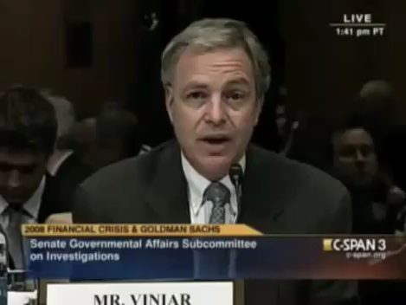
Sen. C. Levin (D, Michigan): When you heard that your employees in these emails and looking at these deals said ‘God, what a shitty deal’, ‘God, what a piece of crap’, when you hear your own employees or read about these in emails, do you feel anything?
Mr D.A.Viniar (CFO, Goldman Sachs): I think that is very unfortunate to have on email.
US Senate, Permanent Subcommittee on Investigations,
27 April 2010
Notes:
https://www.youtube.com/watch?v=ccjZEvBGOuk
https://youtu.be/ccjZEvBGOuk?t=46s
http://www.youtube.com/v/ccjZEvBGOuk?version=3&start=46&end=50&autoplay=1&hl=en_US&rel=0

Slide 5
Who is the asset owner?
The beneficiary with economic interest
The name on the share register
The person who decides to buy and sell
The person who casts vote
The asset owner?/holder?

Slide 6
Three key fiduciary relationships
The trustee and the beneficiary
The asset holder and the investment manager
The company director (executive) and the company

Slide 7
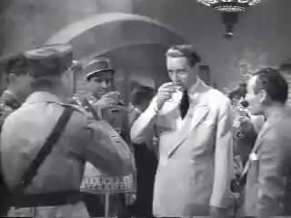
Captain Renault: I’m shocked, shocked to find that gambling
is going on in here!
[a croupier hands Renault a pile of money]
Croupier: Your winnings, sir.
Captain Renault: [sotto voce] Oh, thank you very much.
[aloud]
Captain Renault: Everybody out at once!
Casablanca (1942), Warner Bros

